Slide 1
CS 414 Rollerball Project
Team: String Cheese
Members: Tim Stroup, Chris Schaffer,
Meetkumar Savaliya,
Ya-HsinCheng, Wei Chen

Slide 2
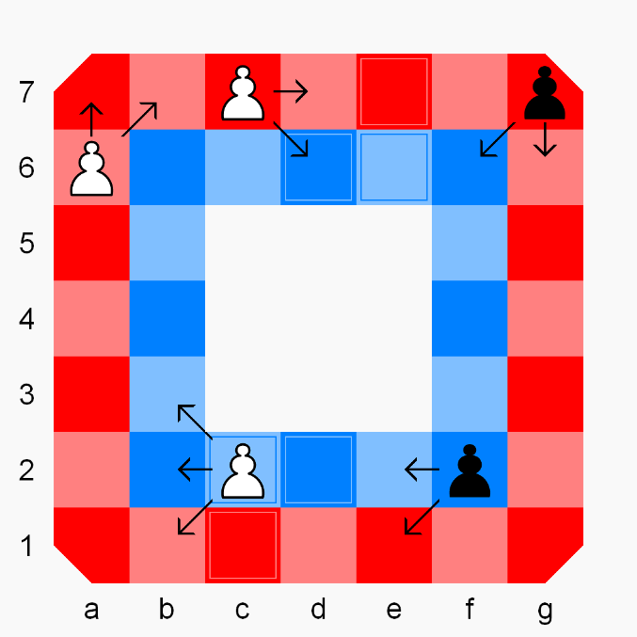
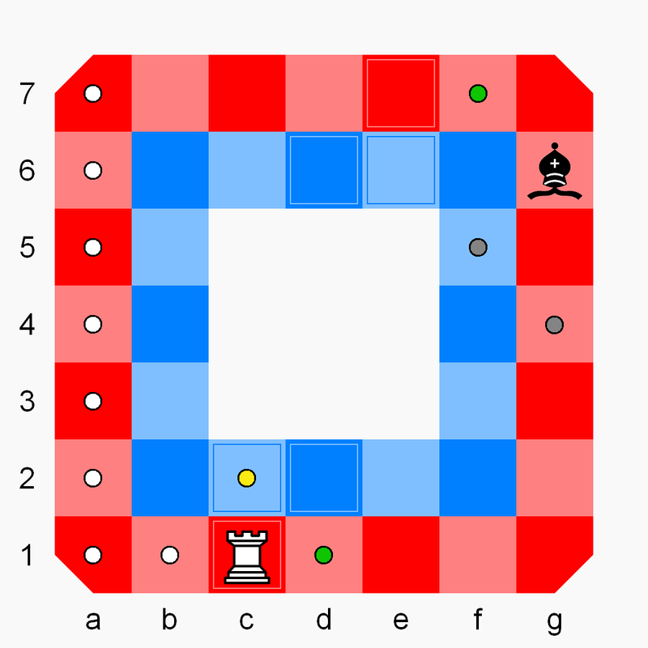
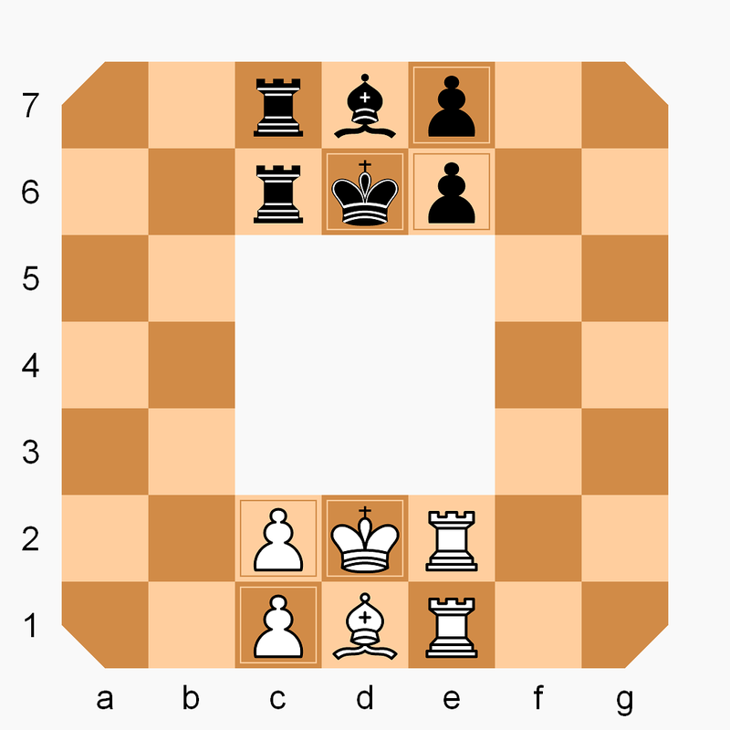
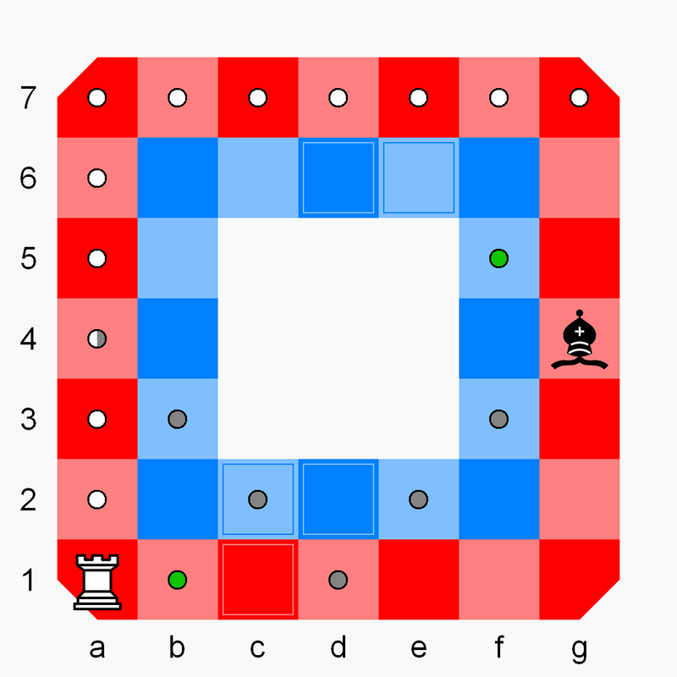
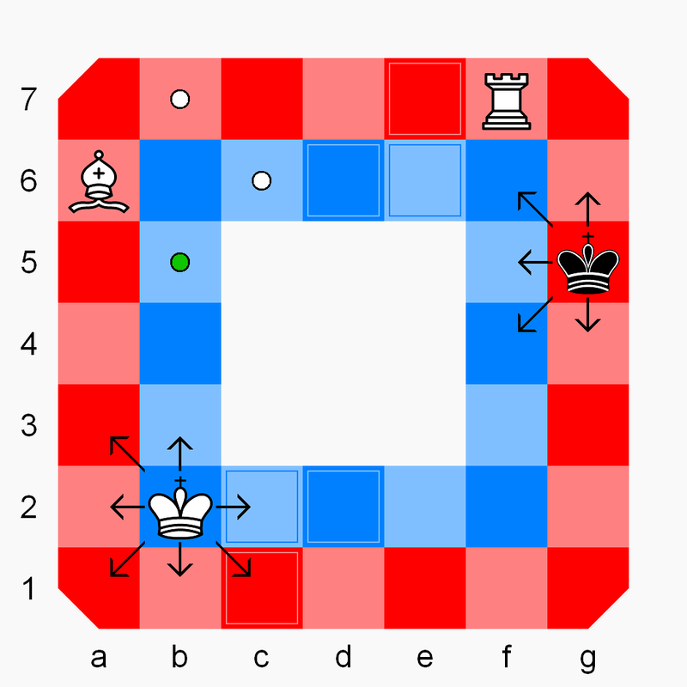
RollerBall

Slide 3
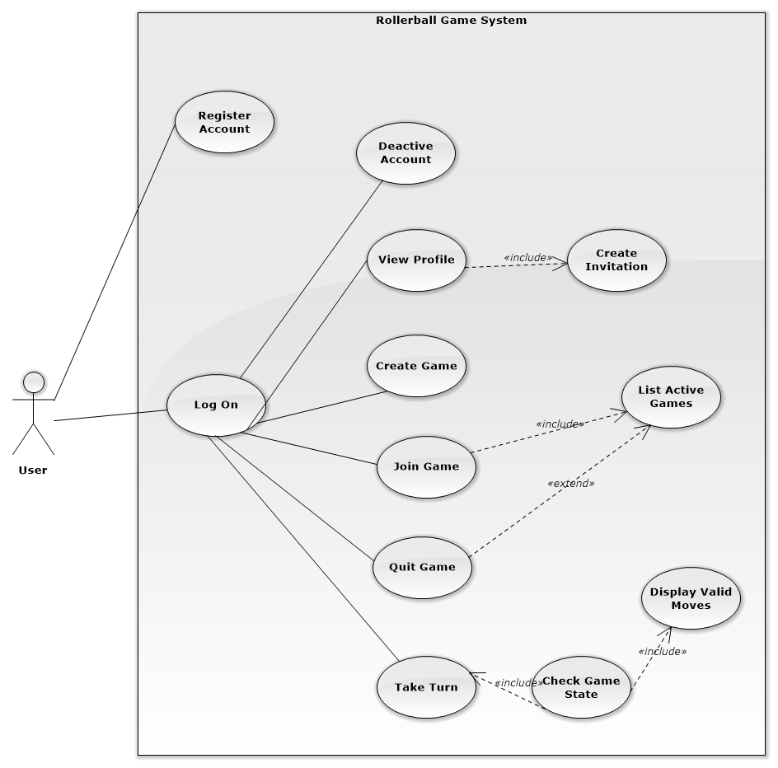

Slide 4
Name | Register Account
Scope | System
Level | User goal
Primary Actor | User
Stakeholder And Interest | User and System
Preconditions | User is connected to the system
Post conditions | User is registered with unique email and nickname
Main Success scenario | 1: User requests to register an account 2: User enters email address, nickname, and password 3: System acknowledges that account was created
Extensions | 2A: invalid email 1: System replies that email is already registered 2: Account is not Created 3: Return to step 1 2B: invalid nickname 1: System replies that nickname is already registered 2: Account is not created 3: Return to step 1
Special Requirements
Name | Deactivate account
Scope | System
Level | User goal
Primary Actor | User
Stakeholder And Interest | User
Preconditions | User is registered and logged in
Post conditions | User account is deactivated
Main Success scenario | 1: User requests to deactivate their account 2: System request to confirm that user would like to deactivate account 3: User account is deactivated and history is deleted 4: Use case ends
Extensions | 2A: cancel deactivation 1: User responds no 2: User account is not deactivated 3: Use case ends
Special Requirements

Slide 5
Name | Create Game
Scope | System
Level | User Goal
Primary Actor | User
Stakeholder And Interest | User
Preconditions | User is registered and logged in to the system
Post conditions | Game is created
Main Success scenario | 1: User requests the system to create game 2: System tells user that game creation was successful
Extensions | 1A: Network error 1: Game is not created 2: Use case ends
Special Requirements
Name | Join Game
Scope | System
Level | User Goal
Primary Actor | User
Stakeholder And Interest | User
Preconditions | User is registered and logged in. User has received an invitation for a game.
Post conditions | User joins Game
Main Success scenario | 1: User requests join match screen 2: User enters game session code 3: User is entered into the game 4: Use case ends
Extensions | 2A: Game is full 1: System responds that game is full 2: User does not join game 3: Use case ends 2B: Game is no longer active 1: System responds that game is no longer active 2: User does not join game 3: Use case ends
Special Requirements

Slide 6
Name | Log game
Scope | System
Level | System subfunction
Primary Actor | System
Stakeholder And Interest | System
Preconditions | Game is quit or game has ended
Post conditions | Game is logged
Main Success scenario | 1: System creates a log of the completed game 2: System stores game result for both players 3: Use case ends
Extensions
Special Requirements
Name | Check game state
Scope | System
Level | System subfunction
Primary Actor | System
Stakeholder And Interest | System
Preconditions | Game is currently in an active state
Post conditions | Game is ended
Main Success scenario | 1: System checks game against rules to determine whether the game is over 2: System invokes marks game as ended 3: System invokes log game 3: Use case ends
Extensions | 1A: Game is not over 1: System does not end game 2: Use case ends
Special Requirements

Slide 7
Name | Display valid moves
Scope | System
Level | System subfunction
Primary Actor | System
Stakeholder And Interest | System
Preconditions
Post conditions | Valid moves are returned
Main Success scenario | 1: System requests to display valid moves for a piece 2: Valid moves are returned
Extensions
Special Requirements
Name | Take Turn
Scope | System
Level | User goal
Primary Actor | User
Stakeholder And Interest | User
Preconditions | User is logged in and registered It is the Users turn
Post conditions | User has moved a piece and turn is over
Main Success scenario | 1: User invokes list active games 2: User selects a game 3: User selects piece to move 4: System invokes Display valid moves 5: User selects move from valid moves 6: piece is moved to new position board is updated 7: Check Game state is invoked 8: Use case ends
Extensions | 6A: Game is invalid 1: System reports that game is no longer valid 2: Use case ends
Special Requirements

Slide 8
Name | List active games
Scope | System
Level | User Goal
Primary Actor | User
Stakeholder And Interest | User
Preconditions | User is registered and logged in.
Post conditions | User’s Active Games are listed
Main Success scenario | 1: User requests to list their active games 2: Active games are listed 3: Use case ends
Extensions | 2a: No active games 1: System responds that there are no active games 2: Use case ends
Special Requirements
Name | Quit game
Scope | System
Level | User Goal
Primary Actor | User
Stakeholder And Interest | User
Preconditions | User is registered and logged in. User has created or joined a game.
Post conditions | User has quit the game
Main Success scenario | 1: List active games­ is invoked 2: User selects and active game from the list 3: User requests to quit the game. 4: System invokes log game and marks it as invalid 5: Use case ends
Extensions
Special Requirements

Slide 9
Name | Log on
Scope | System
Level | subfunction
Primary Actor | User
Stakeholder And Interest | User
Preconditions | User is Registered.
Post conditions | User is logged in
Main Success scenario | 1: User enters nickname and password 2: User requests to log on to the system 3: User is logged in 4: Use case ends
Extensions | 2A: invalid password or nickname 1: System reports password or nickname does not match a valid pair 2:User is not logged in 3: Use case ends
Special Requirements
Name | View Profile
Scope | System
Level | User Goal
Primary Actor | User
Stakeholder And Interest | User
Preconditions | User is registered and logged in. List registered users has been called
Post conditions | User profile is shown
Main Success scenario | 1: User invokes list Registered Users 2: User selects user from list 2: User requests to view profile 3: Profile information is displayed 4: Use case ends
Extensions
Special Requirements

Slide 10
Name | Create Invitation
Scope | System
Level | User Goal
Primary Actor | User
Stakeholder And Interest | User
Preconditions | User is registered, logged in, and has created a game
Post conditions | Invitations are sent
Main Success scenario | 1: User requests to create an invitation for a game 2: List Registered Users is called 3: User selects recipients of the invitation from the list 4: User requests to send the invitation 5: Use case ends
Extensions | 1A: Invalid Game 1: System reports that you cannot create an invitation for this game 2: Use case Ends 4A: Network error 1: System reports it cannot send an invitation 2: Use case ends
Special Requirements

